Slide 1
Lending Club Case Study
Venkatesh NG

Slide 2
Problem summary
Lending Club is a consumer finance marketplace for personal loans that matches borrowers who are seeking a loan with investors looking to lend money and make a return. It specializes in lending various types of loans to urban customers. When the company receives a loan application, the company has to make a decision for loan approval based on the applicant's profile.
Like most other lending companies, lending loans to ‘risky’ applicants is the largest source of financial loss (called credit loss). The credit loss is the amount of money lost by the lender when the borrower refuses to pay or runs away with the money owed. In other words, borrowers who default cause the largest amount of loss to the lenders. In this case, the customers labelled as 'charged-off' are the 'defaulters’. The core objective of the exercise is to help the company minimize the credit loss.
Applicant likely to repay the loan, such an applicant will bring in profit to the company with interest rates. Rejecting such applicants will result in loss of business.
Applicant not likely to repay the loan, i.e. and will potentially default, then approving the loan may lead to a financial loss* for the company.

Slide 3
Observations
We have analyzed the provided data set and observed that the probability of defaulting is more when the
- Applicant in RENTAL home
- Who use the loan to clear other loans
- Applicants with income 30k to 50k
- When loan status is not verified
- With interest rate 13 to 17%
- 2011 more defaulters may be because of economic slowdown
- loan amount is between 5k to 10k
- loans taken during the year end
- 2 to 10 open credit lines
- 60 to 100 % revolving line utilization rate
- Loans with longer duration
- loans taken for smaller businesses

Slide 4
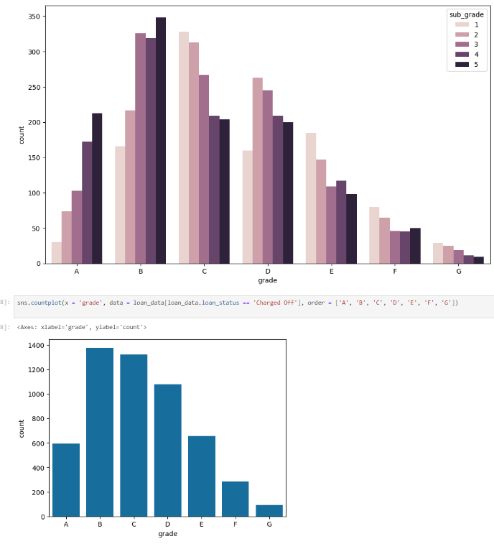
Reports grade vs loans count

Slide 5
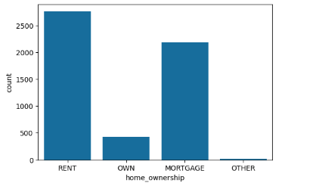
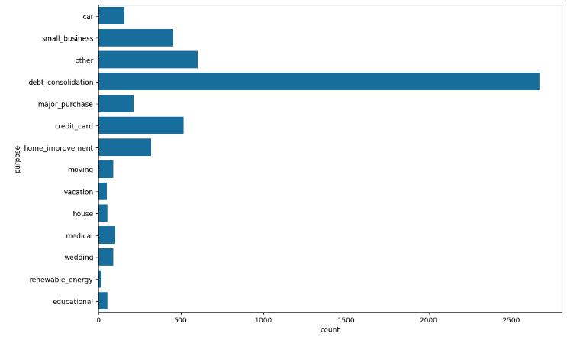
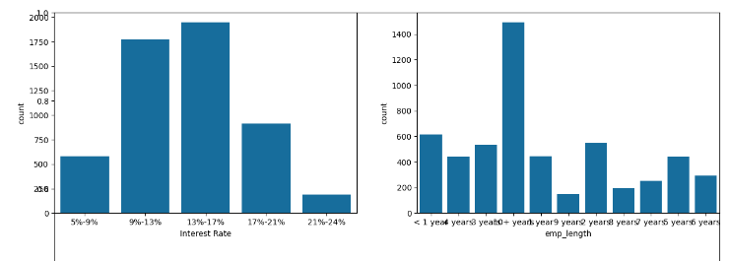
Home ownership vs loans count
Loan purpose vs loans count with charged off status
Interest rate vs loans count
Employee tenure vs loans count

Slide 6
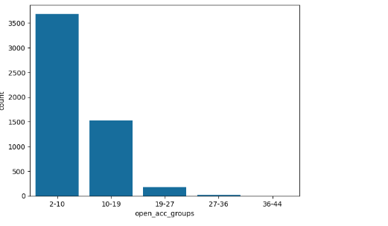
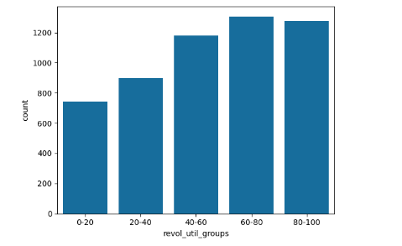
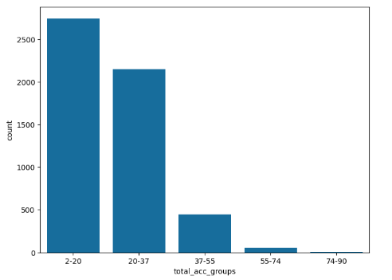
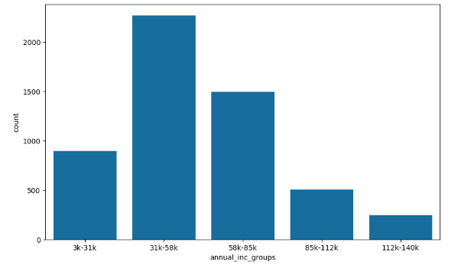
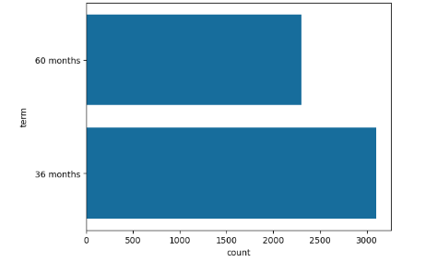
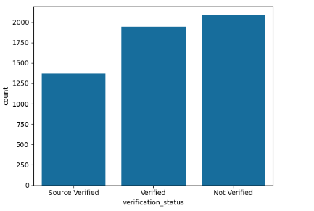
Open credit lines vs loans count
Revolving utilization rate vs loans count
Total credit lines vs loans count
Annual income vs loans count
Loan duration vs loans count
Loan verification status vs loans count

Slide 7
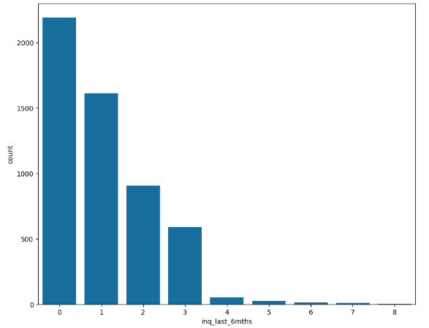
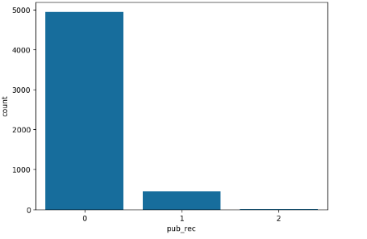
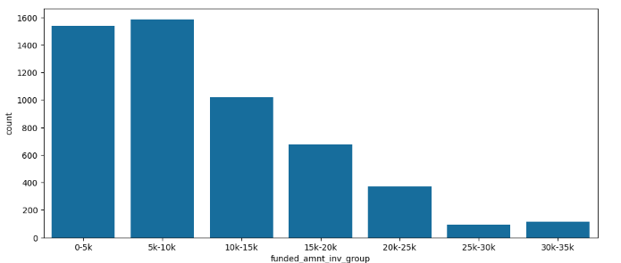
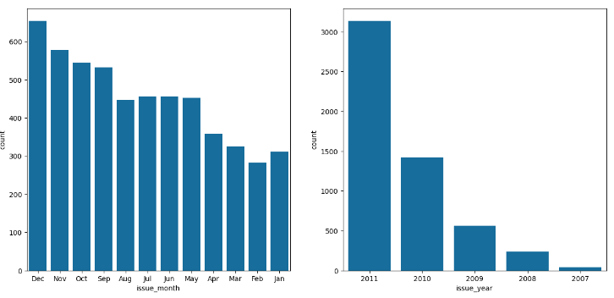
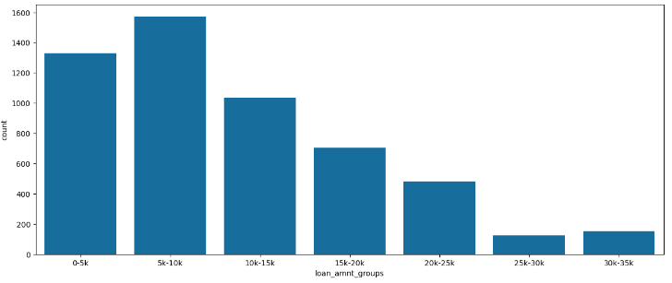
Num of enquiries vs loans count
Derogatory public records vs loans count
Funded amount vs loans count
Loan issued month and year vs loans count
Total loan amountapplied vs loans count

Slide 8
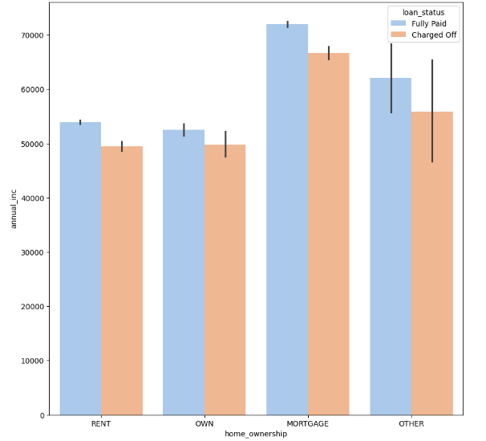
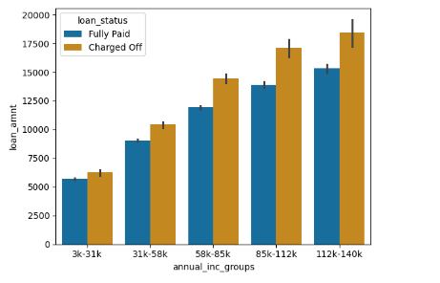
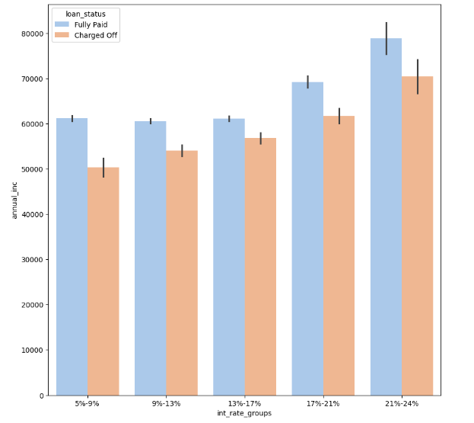
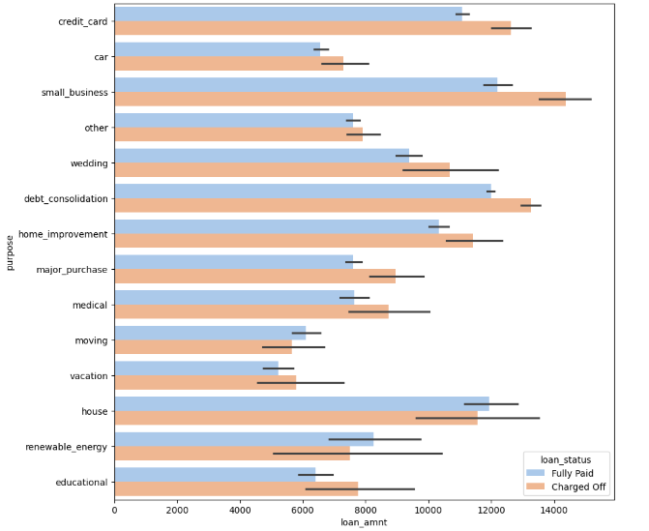
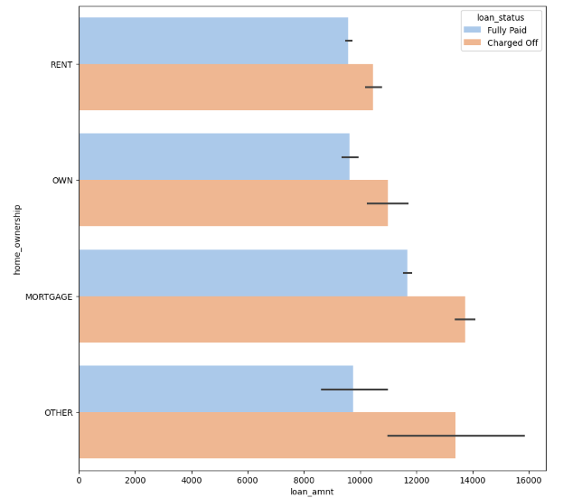
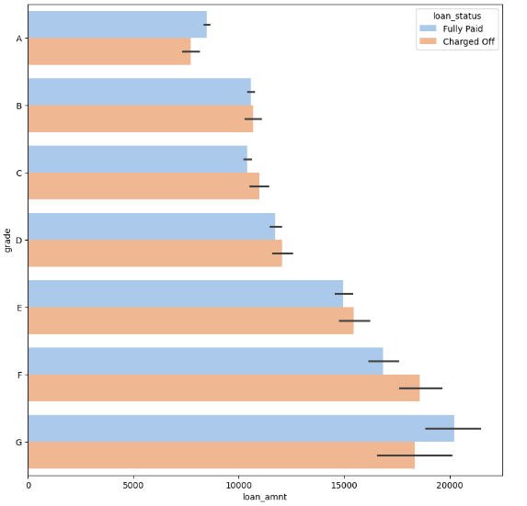
Home ownership vs annual income
Annual income vs loan amount with loan status
Interest rate vs Annual income
Purpose vs loan amount
Home ownership vs loan amount
Grade vs loan amount

